Slide 1
Open Domain Question Answering
Kangqi Luo
2014-04-30

Slide 2
Agenda
Overview
Approaches
Semantic Parsing
Shallow Parsing
Current Proposal
Conclusion
Notes:
Shallow Parsing: yes, the question is still need to be parsed, but not so deep as CCG/DCS

Slide 3
Shallow Parsing
Coarse-grained parsing strategy
Still need to convert a question into a formal representation.
Not combining each word’s semantic representation
Notes:
Since they don’t care how the words combine with each other, shallow parsing sometimes only deal with fq with simple structure.
Because we don’t care the structure of the question, it’s hard to get a final expression with a complex structure.

Slide 4
Template-Based Model
Mainly focus on factoid question with simpler structure
“How many people are there in Honolulu?”
population(honoulu, ?)
“Who is the director of Avatar?”
directed_by(Avatar, ?)
……
Questions can be answered with single-predicate queries.

Slide 5
Template-Based Model
Different questions can ask for a same relation:
“Where was Barack Obama born?”
“Where was Yao Ming born?”
“Where was Shakespeare born?”
……
Generalize: “Where was $person born?”
That is a template.
Representing a set of questions with the same meaning.
Notes:
parsing是一种把问题用另一个形式去描述 (shallow parse)
That is a question template, or say, a general question, or say, representing a set of questions with the same meaning
“Once we know the predicate behind a template, we can easily answer a new question that satisfies this template.”

Slide 6
Template-Based Model
Need to do
A. Learn the question templates.
B. Find the proper predicate behind each template.
Learned by existed QA pairs.
Training data: <Question, Answer> pairs from Yahoo! Answers
Q: “Where was Mark Twain born?”
A: “The novelist was born in Florida.”
Notes:
Actually, a learning process
here answer is a slightly different from what we said before. it’s a short text provided by users, containing the value of the question.
we ignore the process of answer extraction.

Slide 7
Template-Based Model
A. Template Learning
Step 1. Entity Recognition
Distance between candidate entities and the answer in FB.
Q: “Where was Mark Twain born?” A: “Florida”
Best: Mark Twain (Novelist)
Candidate Entities | Shortest Path to Reach “Florida” in FB
Mark Twain (Novelist) | mark_twain → place_of_birth → florida
Mark Twain (Film) | mark_twain → director → ken_burns → nationality → united_states → contains → florida
Born (Comic book) | born → created_by → darick_robertson → nationality → united_states → contains → florida

Slide 8
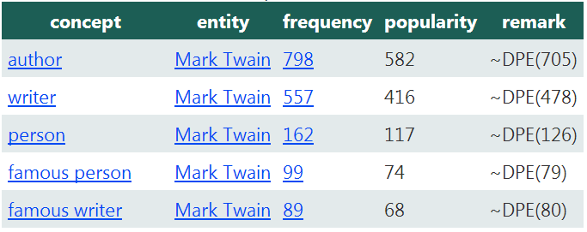
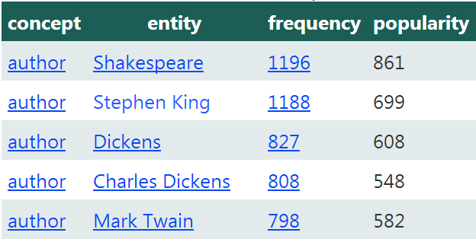

Template-Based Model
A. Template Learning
Step 2. Entity Conceptualization
Leverage Probase typicality
$P\left(C | e\right)∝P\left(e | C\right)P(C)$
Q: “Where was Mark Twain born?” A: “Florida”
“Where was $author born?”, p=0.4
“Where was $writer born?”, p=0.35
“Where was $person born?”, p=0.2
……
Notes:
Entity Conceptualization: Get the entity’s concept distribution
Probase typicality: How typical the concept is, when the entity comes into your mind.
Actually the typicality score is a computational challenge, since it’s not so close to our human thought.
Challenge: Probase without disambiguation.
Here, p: weight of the question, given the template.

Slide 9

Template-Based Model
B. Predicate inference for each template
Through training QA pairs.
$P\left(P | T\right)∝P\left(P,T\right)=\sum_{q}{P\left(q\right)P\left(T | q\right)P\left(E,V | q\right)P(P|E,V)}$
Template → Questions → <Entity, Value> pairs → Predicate
E
Q
A
V
P
place_of_birth
T
where was $person born?
Notes:
What we have: A list of QA pairs.
Once T is given, it’ll guide the system to find related QA pairs. then based on these pairs, find the most suitable predicate

Slide 10
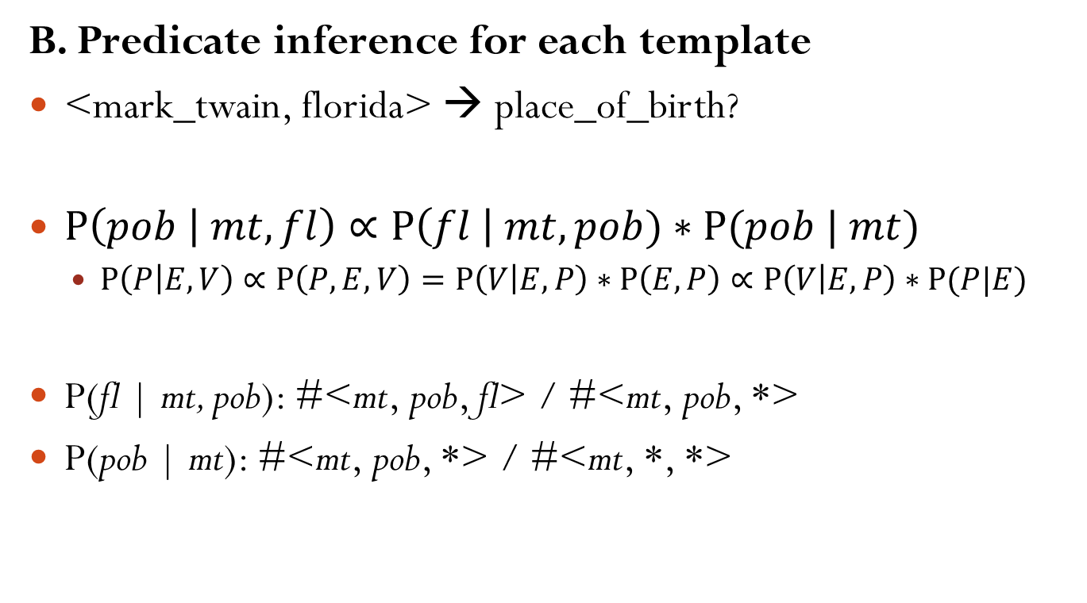
Template-Based Model
B. Predicate inference for each template
<mark_twain, florida> → place_of_birth?
$P\left(pob | mt, fl\right)∝P\left(fl \right| mt, pob)∗P(pob | mt)$
$P\left(P | E,V\right)∝P\left(P,E,V\right)=P\left(V | E,P\right)∗P\left(E,P\right)∝P\left(V | E,P\right)∗P(P|E)$
P(fl | mt, pob): #<mt, pob, fl> / #<mt, pob, *>
P(pob | mt): #<mt, pob, *> / #<mt, *, *>
Notes:
可以用白板笔在白板上推导，而不用写ppt
<S, P, O>: triple in Freebase.

Slide 11
Template-Based Model
Finally… A new question comes.
“Where was Hu Jintao born?”
Template distribution
“Where was $person born?”
“Where was $politician born?”
Predicate: place_of_birth(entity, value)
Learned by QA pairs
Final expression: place_of_birth(hu_jintao, ?)
Query & Answer: “Tai Zhou”

Slide 12
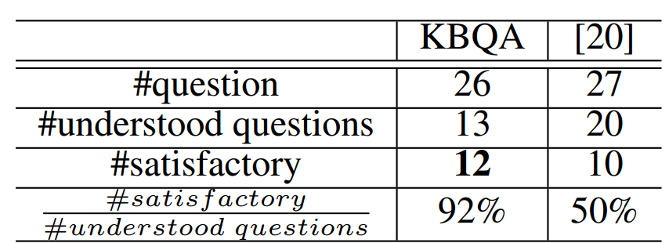
TBM Precision
Dataset: QALD (Question Answering on Linked Data)
26 single-relation questions from the dataset.

Slide 13
Current Proposal
Directly matching a question to the query tree in KB.
Without semantic parsing process.
“What year did the knicks win the championship?”
Answer
start_date
Sports League
Championship Event
New York Knicks
championships
?
Notes:
Data flow chart: sentence → Sp → final exp → sparql | sentence → exp → sparql
query tree is actually a subgraph in the KB data network.

Slide 14
Basic Idea
Step 1. Find the arguments (entities / types) that is necessary for the query tree.
Step 2. Find a minimum tree structure to connect entities in the knowledge base.
Step 3. Link the answer node to the tree structure.
Step 4. Scoring the final query tree.

Slide 15
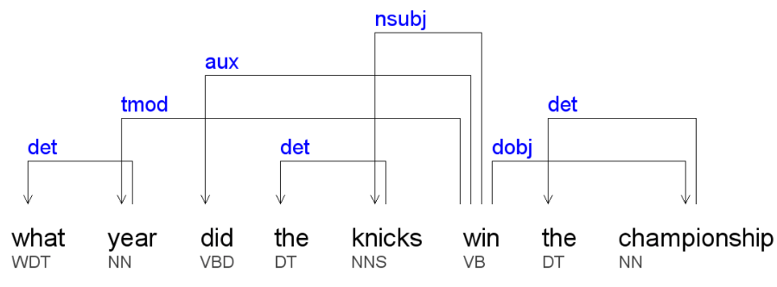
Step 1: Argument Recognition
Key point: syntactic analysis
“what year did the knicks win the championship?”
Argument text:
Subject: “the knicks”
Object: “the championship”
Answer & Temp. Modifier: “what year”
Predicate phrase: “did … win”

Slide 16
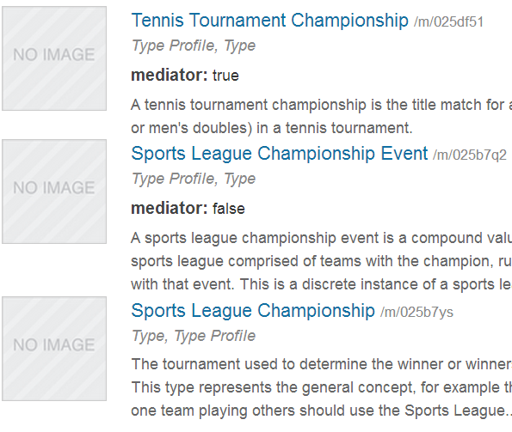
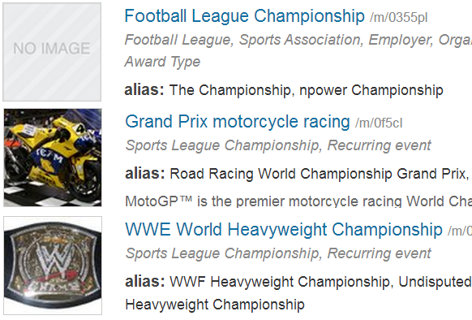
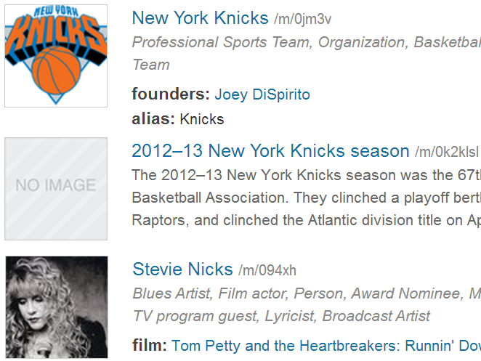
Step 1: Argument Recognition
Each text shall be either an entity, or a type.
“the knicks”: New_York_Knicks …
“the championship”:
entity: Football_League_Championship …
type: Sports_League_Championship_Event …
“what year”: datetime, year …
Notes:
try every combination…

Slide 17
Step 2: Tree Construction
Sports League
Championship Event
champ-ionships
1970 NBA Finals
champ-ionship
New York Knicks
1973 NBA Finals
The NBA Finals
Sports League
Championship
member of
NBA
champ-ionship
headquarters
(country)
WWE Cha-mpionship
USA
nationality
Stevie Nicks
Bella Donna
Album
albums
Notes:
在board上先写好entity/type的可能性。然后用ppt动画打出每一个可能的linking way。
把type放进来，就是因为type代表了entity的集合。在最终使用的时候，还是只对应了某一个entity。
scoring只考虑边，暂时不考虑中间的entity，这样可以忽略1970/1973的区别。
边的名字，还有其他的东西。这一步可能就暗含了与verb的对应。（后面的relation linking也是整个semantics的一部分，对于verb而言，当然是在主语和宾语之间的联系才会体现，所以verb的scoring可以在Step2和Step3进行，但是step3会涉及到class）
肯定会问，为什么不走NBA，这些边上面都带了championship。
我这么问吧，问题就是when did new york knicks win the nba finals? entity都明确了，为什么不走nba，而是走另一条？
因为有一条边带了championship，champion，并且我知道了win和champion/championship的关系比较密切；（必须这么统计，其它的信息只有1973 NBA Finals是一个event，或者mediator，而NBA不是。）
注意，每一个得到的路径都可以成为candidate，通过popularity进行一个统计。

Slide 18
Step 3: Answer linking
Link the answer node to the tree structure by a FB relation.
Link to which entity?
Not too close to entities directly extracted from the question.
Which relation?
Target type of the relation is near the description in the question.
Notes:
Answer type should be near the induced type in the description.
“What year”, tmod
datetime, Year,…… (with distribution)

Slide 19
Step 3: Answer linking
“what year” → datetime …
New York Knicks
location
Location
founders
Org. Founder
Sports League
Championship Event
previous_ coach
founded
mediator (coaching)
from
1973 NBA Finals
Datetime
start_date
Notes:
只留下entity久可以了，反正边不会连在type上 (relation searching)
然后进行type match & type compare (再来一个例子就知道连在哪里是有意义的)
intuition: 离已知的entity远一点。
当已经确定了entity之后，面对type一致的relation，就只能通过semantic relatedness了
prefer this relation, that links a championship event to a datetime.

Slide 20

Step 3: Answer Linking
“who played bilbo baggins in hobbit?”
“who” → person …
$∀entity∈\text{actor}, entity∈\text{person}$
Actor
Director
actor
directed_by
Mediator
(film performance)
the hobbit: an unexpected journey
bilbo baggins
Notes:
Build the graph, showing the overlap between people and actor.
(What we finally get?)

Slide 21
Step 4: Scoring & Ranking
One of the final query graph:
“what year did the knicks win the championship?”
Answer
start_date
Sports League
Championship Event
New York Knicks
championships
?

Slide 22
Step 4: Scoring & Ranking
Each step makes a contribution to the score.
object popularity, edit distance
relation popularity
weighted length of tree
semantic similarity
type overlap
Final score: weighted sum of features.
Trained by existed QA pairs.
Notes:
The query graph is built step-by-step.
(how many nodes have the rel.)

Slide 23
Challenges
Computational complexity
Relation searching
Combination over arguments
Gap between FB structure and NL description
Argument adjustment

Slide 24
Conclusion
Key: convert a question to a structured representation in KB
Understood by computer
Room for Improvements
Computation speedup
More accurate ways to perform relation mapping
Extract high quality factoid QA pairs
Fuzzy match technique in template-based model
Question paraphrase
Notes:
917 sentences to learn CCG?
Yahoo answers not reliable?
Semantic Gap. between KB and question desc.

Slide 25
Reference
CCG
Scaling Semantic Parsers with On-the-fly Ontology Matching
Kwiatkowski et al., EMNLP 2013.
Lexical generalization in CCG grammar induction for semantic parsing
Kwiatkowski et al., EMNLP 2011.
Template-Based Model
KBQA: Question Answering over a Billion Scale Knowledge Base
Xiao et al., Draft for VLDB 2014.

Slide 26
Thanks For Listening!
Q & A

